Slide 1
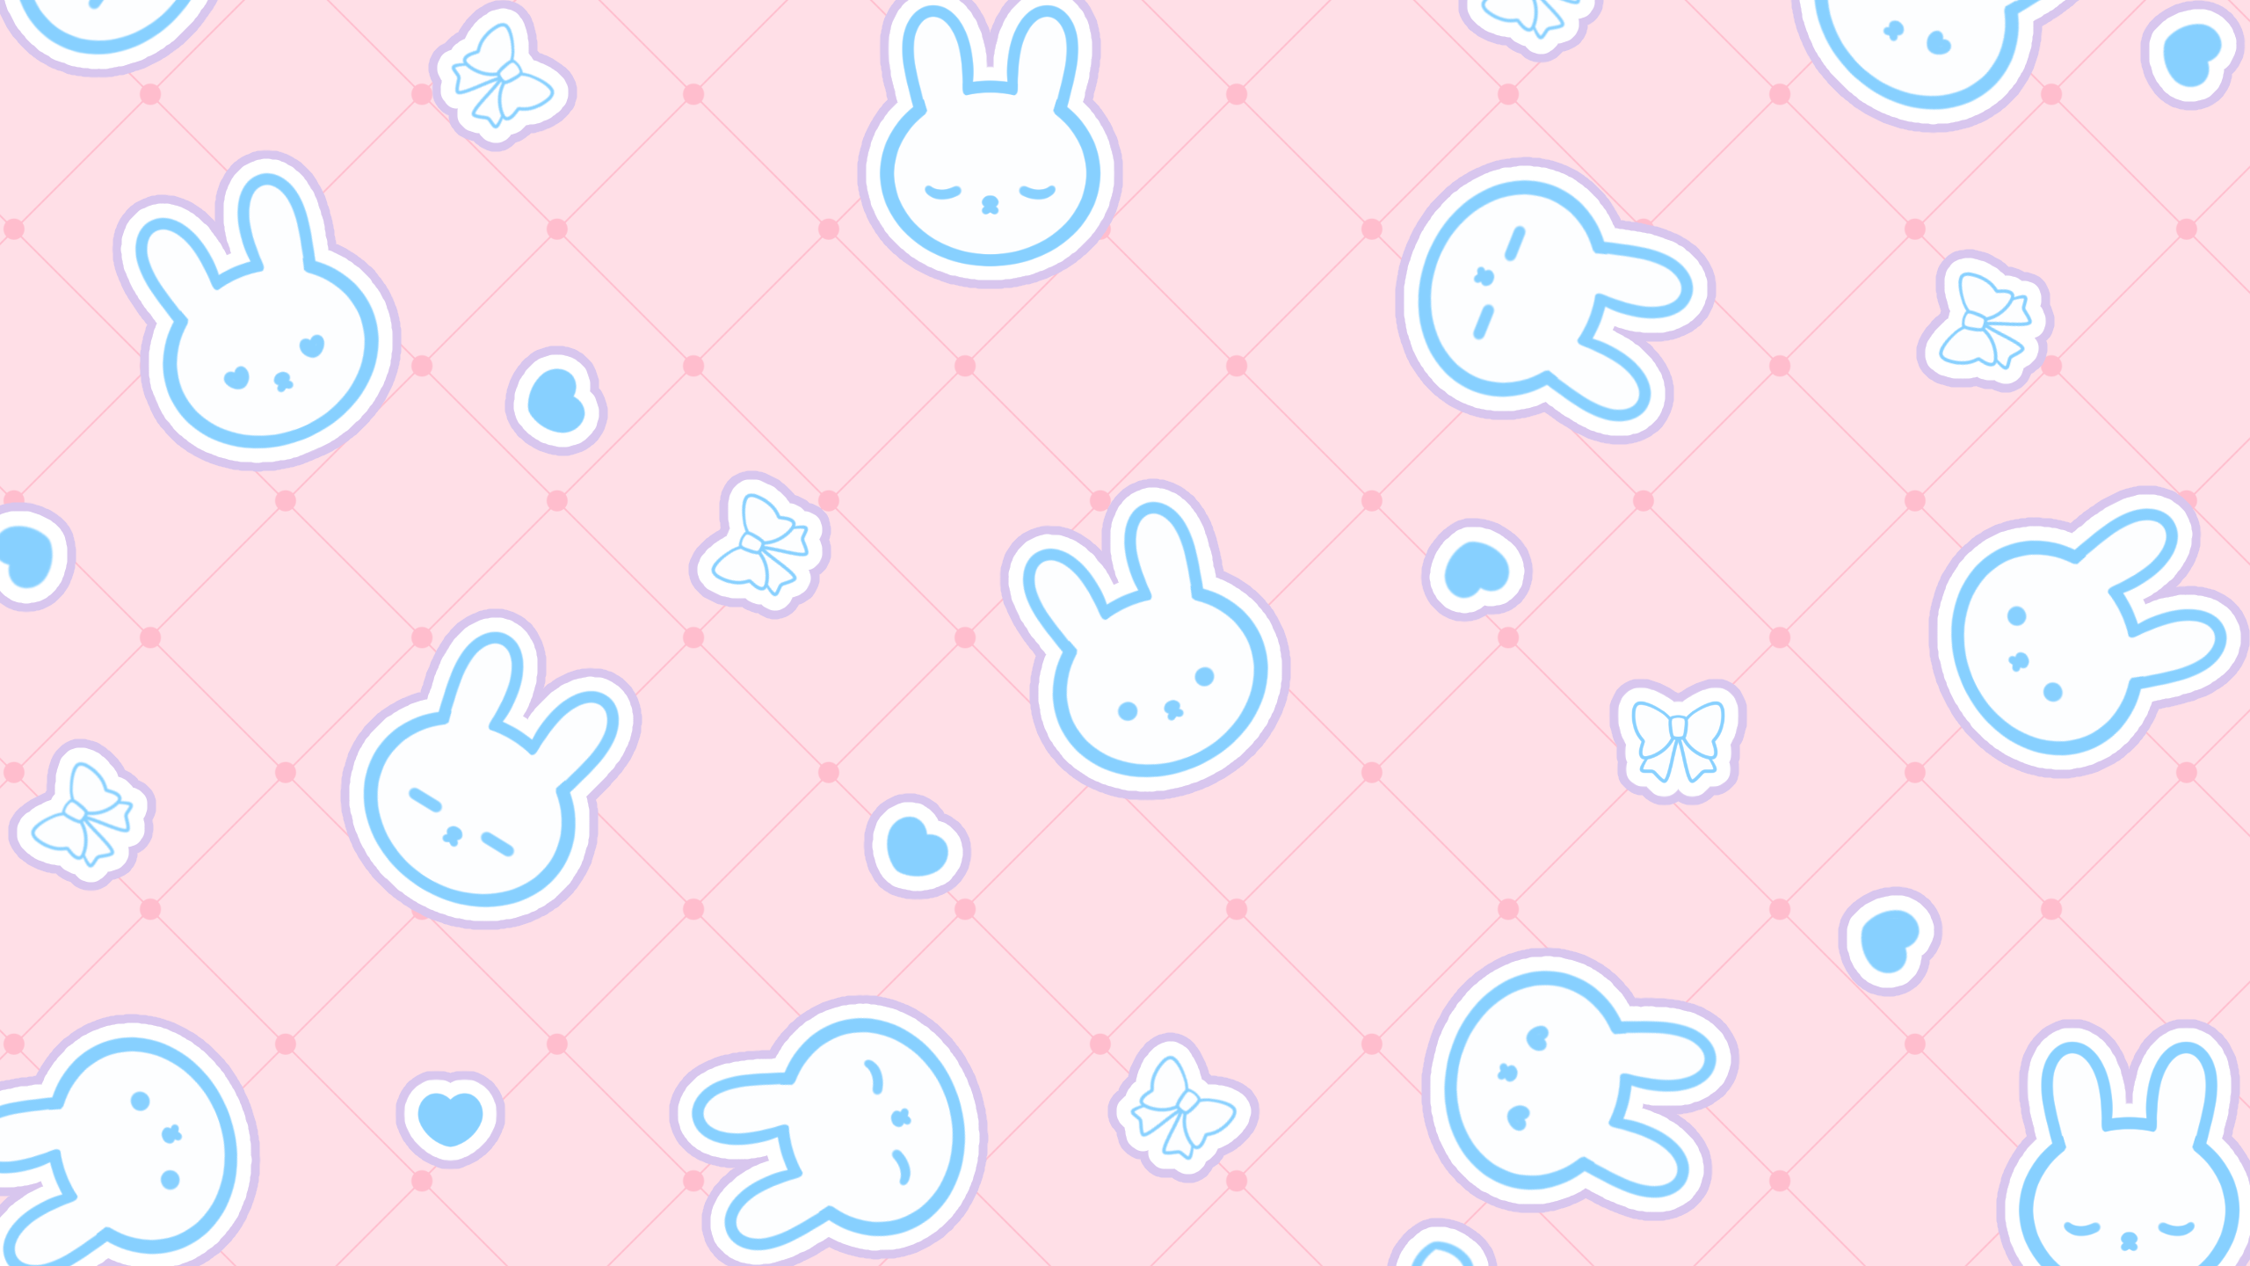

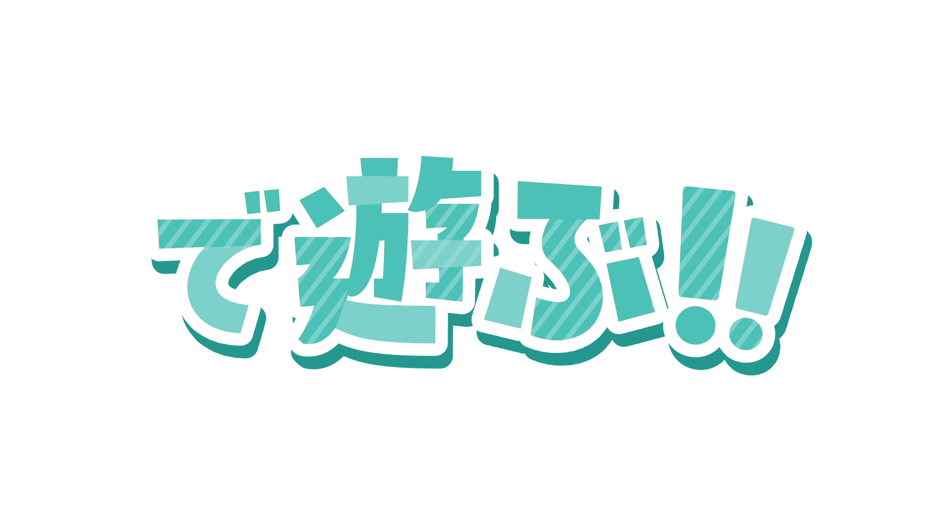
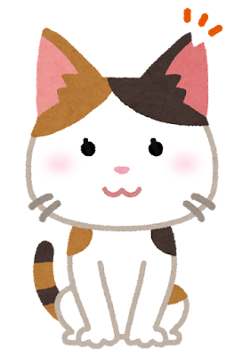
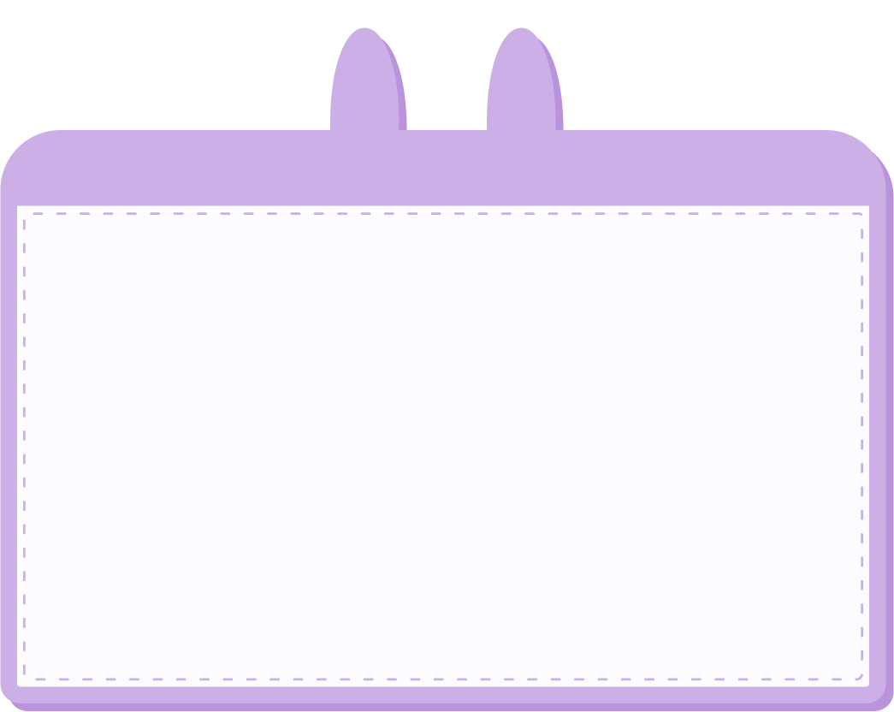
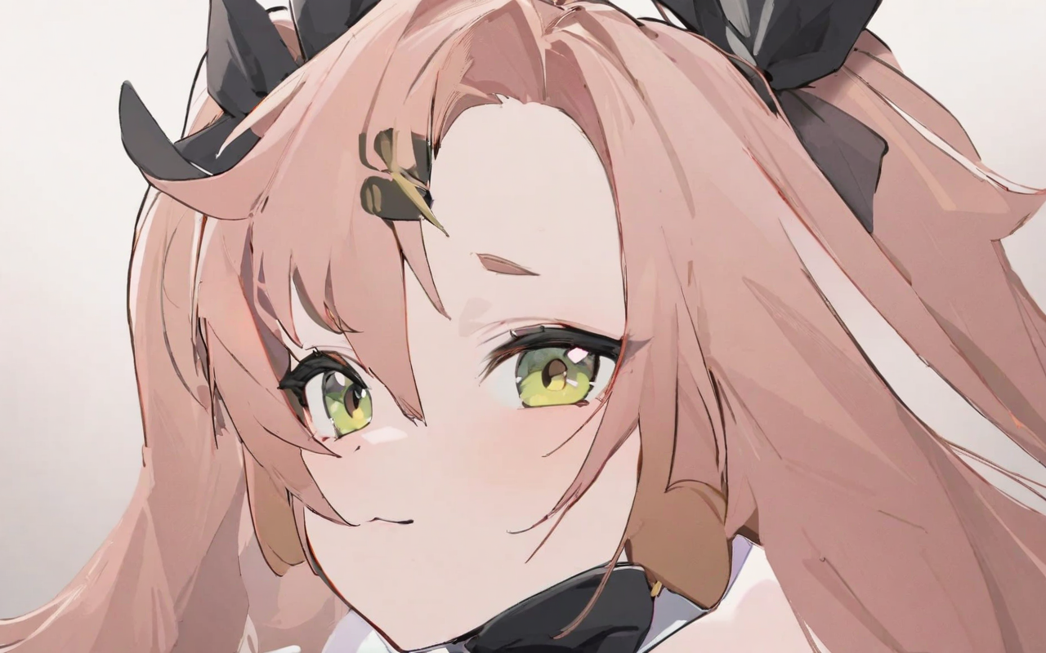
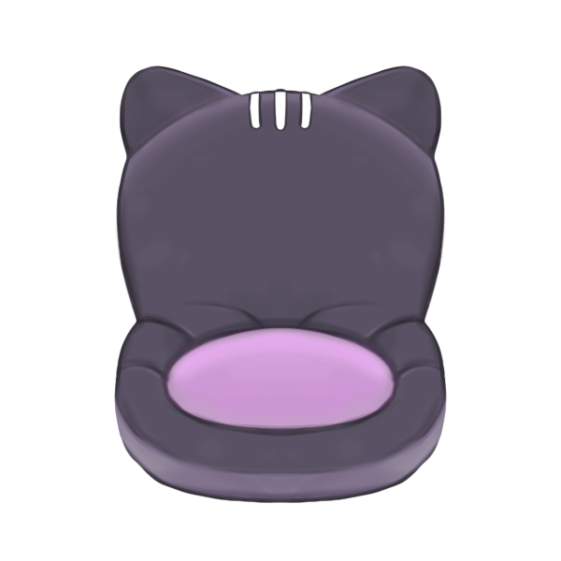
1.目標
Notes:
1girl,,two_side_up,solo,large_breasts,highres,nicole_demara,1girl,hair_ribbon,crop_top,looking_at_viewer,portrait,looking at viewer,,masterpiece,best quality,absurdres,newest,higher<lora:nicole_demara_v31:1>

Slide 2
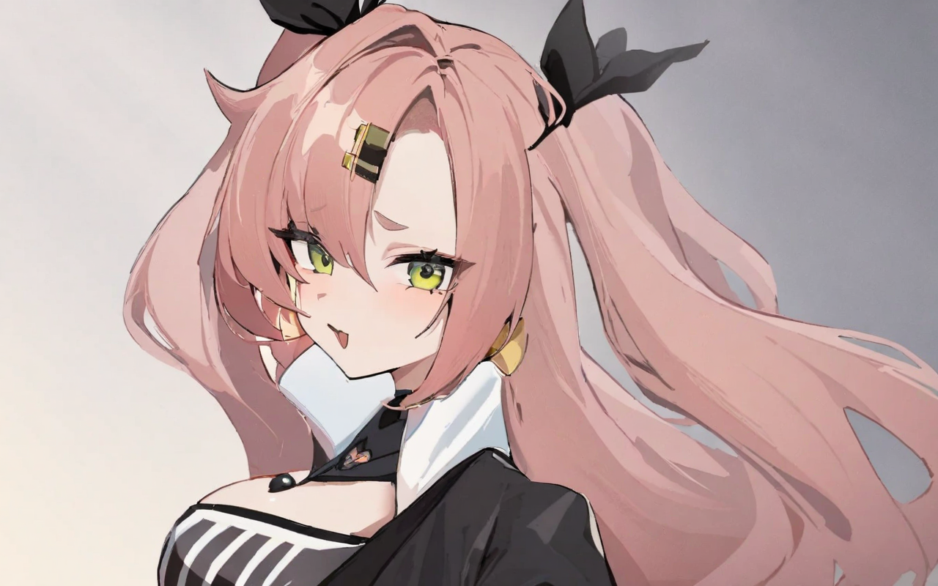
2.阻礙
Notes:
1girl,,two_side_up,solo,large_breasts,highres,nicole_demara,1girl,hair_ribbon,crop_top,looking_at_viewer,portrait,looking at viewer,,masterpiece,best quality,absurdres,newest,higher<lora:nicole_demara_v31:1>

Slide 3
3.努力
Notes:
1girl,,two_side_up,solo,large_breasts,highres,nicole_demara,1girl,hair_ribbon,crop_top,looking_at_viewer,portrait,looking at viewer,,masterpiece,best quality,absurdres,newest,higher<lora:nicole_demara_v31:1>

Slide 4
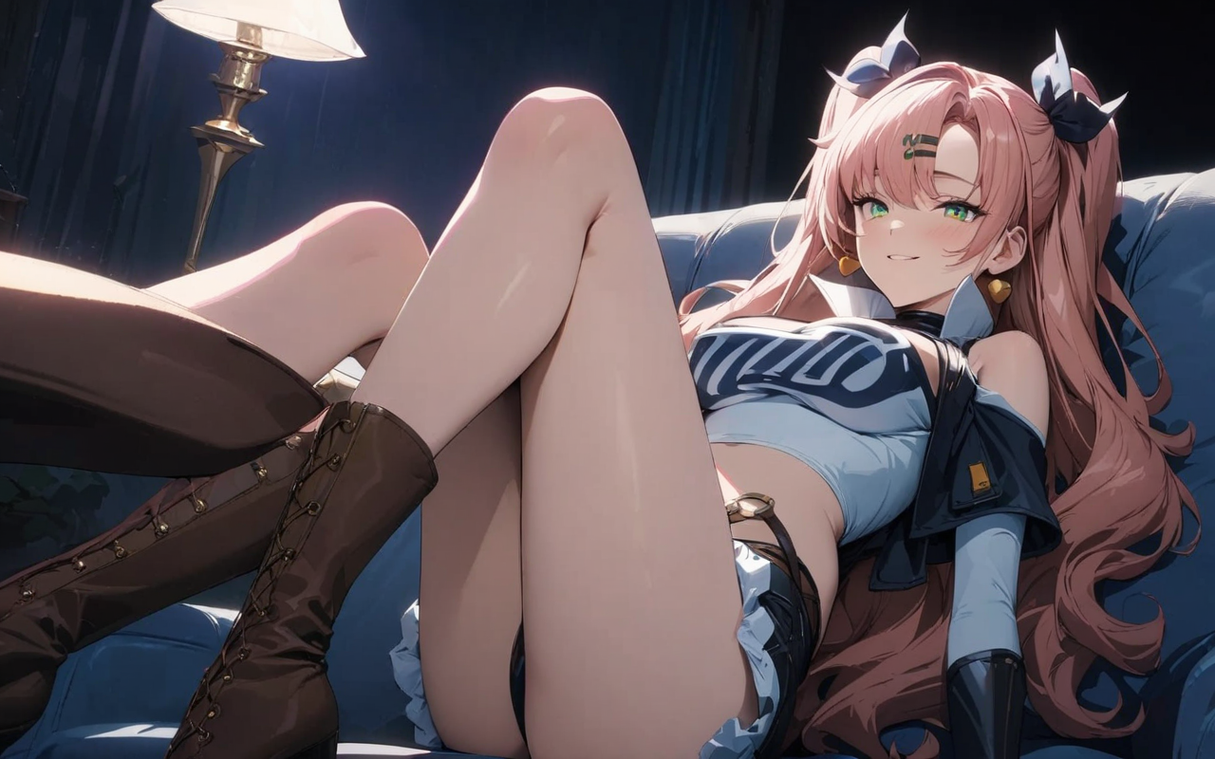
4.結果
Notes:
score_9, score_8_up, score_7_up, score_6_up, score_5_up, score_4_up, BREAK source_anime, 1girl, solo, outdoors, city, cowboy shot, looking at viewer, smile, closed mouth, nicole, green eyes, pink hair, long hair, two side up, black hair ribbon, black hair clip, black blazer, open jacket, collared shirt, long sleeves, black necktie, black pants, leaning forward, hands on pocket, standing, golden earrings, heart earrings

Slide 5
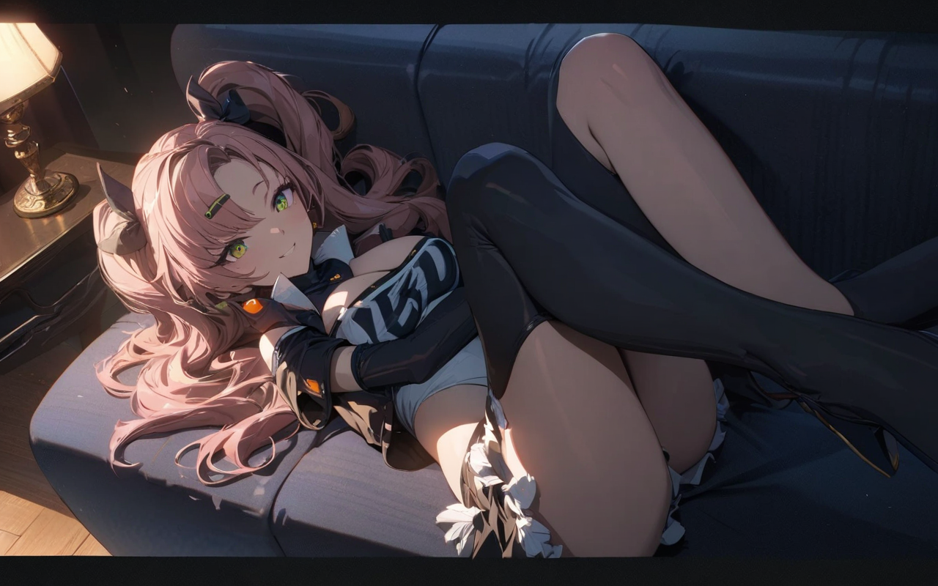
5.意外
Notes:
score_9, score_8_up, score_7_up, score_6_up, score_5_up, score_4_up, BREAK source_anime, 1girl, solo, outdoors, city, cowboy shot, looking at viewer, smile, closed mouth, nicole, green eyes, pink hair, long hair, two side up, black hair ribbon, black hair clip, black blazer, open jacket, collared shirt, long sleeves, black necktie, black pants, leaning forward, hands on pocket, standing, golden earrings, heart earrings

Slide 6
6.轉彎
Notes:
score_9, score_8_up, score_7_up, score_6_up, score_5_up, score_4_up, BREAK source_anime, 1girl, solo, outdoors, city, cowboy shot, looking at viewer, smile, closed mouth, nicole, green eyes, pink hair, long hair, two side up, black hair ribbon, black hair clip, black blazer, open jacket, collared shirt, long sleeves, black necktie, black pants, leaning forward, hands on pocket, standing, golden earrings, heart earrings

Slide 7
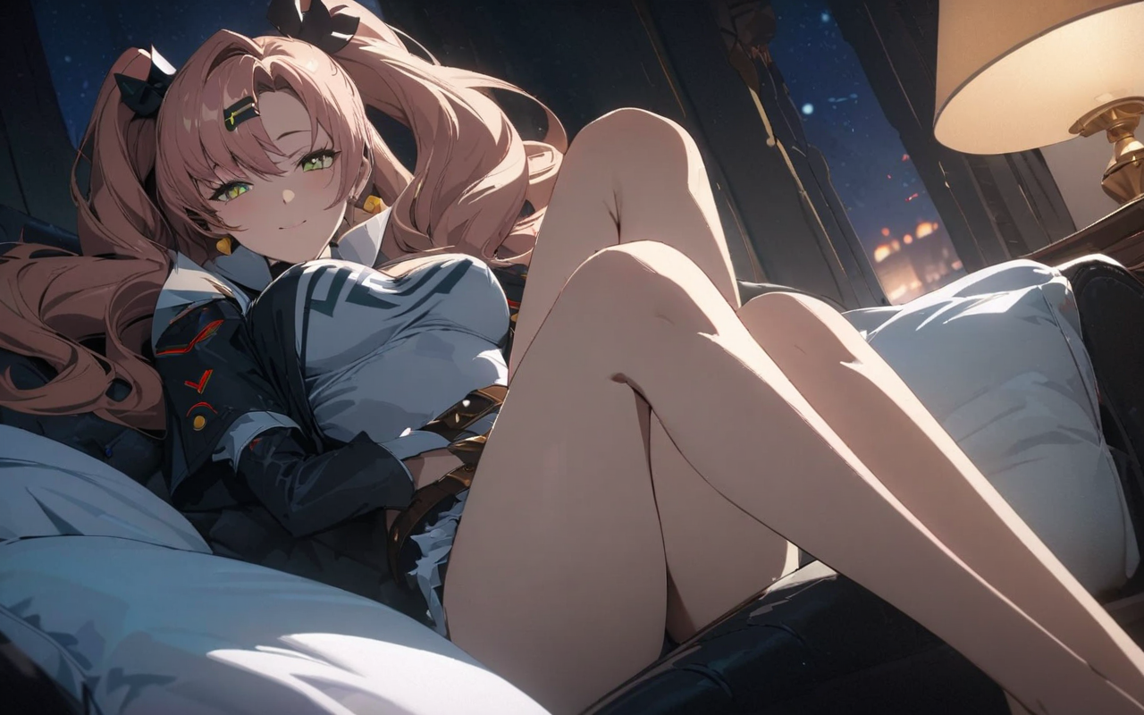
7.結局
Notes:
score_9, score_8_up, score_7_up, score_6_up, score_5_up, score_4_up, BREAK source_anime, 1girl, solo, outdoors, city, cowboy shot, looking at viewer, smile, closed mouth, nicole, green eyes, pink hair, long hair, two side up, black hair ribbon, black hair clip, black blazer, open jacket, collared shirt, long sleeves, black necktie, black pants, leaning forward, hands on pocket, standing, golden earrings, heart earrings

